Slide 1
Introduction to Clinical Pharmacology Chapter 23 Adrenergic Drugs

Slide 2
Learning Objectives
Discuss the activity of the autonomic nervous system, specifically the sympathetic branch.
Compare and contrast the types of shock, physiologic responses of shock, and the use of adrenergic drugs in the treatment of shock.
Explain the uses, general drug actions, contraindications, precautions, interactions, and adverse reactions associated with the administration of adrenergic vasopressor drugs.
Distinguish important preadministration and ongoing assessment activities the nurse should perform on the client taking an adrenergic drug.
List nursing diagnoses particular to a client taking an adrenergic drug.
Examine ways to promote an optimal response to therapy, how to manage common adverse reactions, and important points to keep in mind when educating clients about the use of adrenergic drugs.

Slide 3
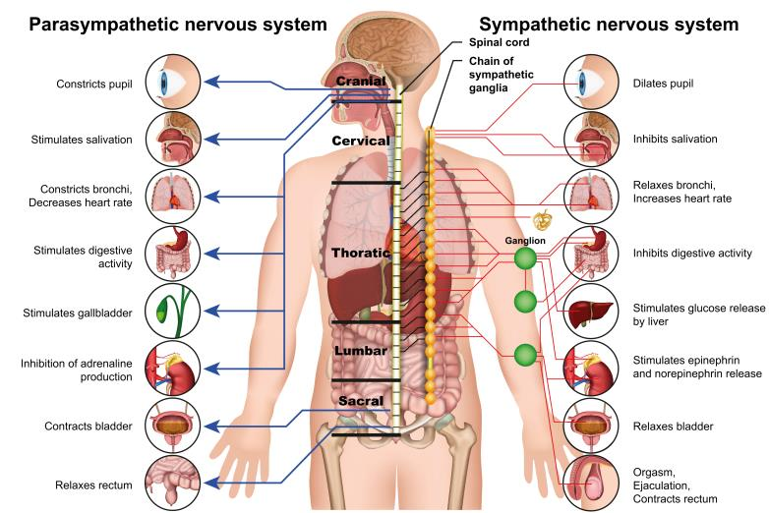
Autonomic Nervous System
Division of the peripheral nervous system concerned with the functions essential to life of an organism and not consciously controlled (e.g., blood pressure, heart rate, and gastrointestinal activity)
Divided into two branches:
Sympathetic
Parasympathetic

Slide 4
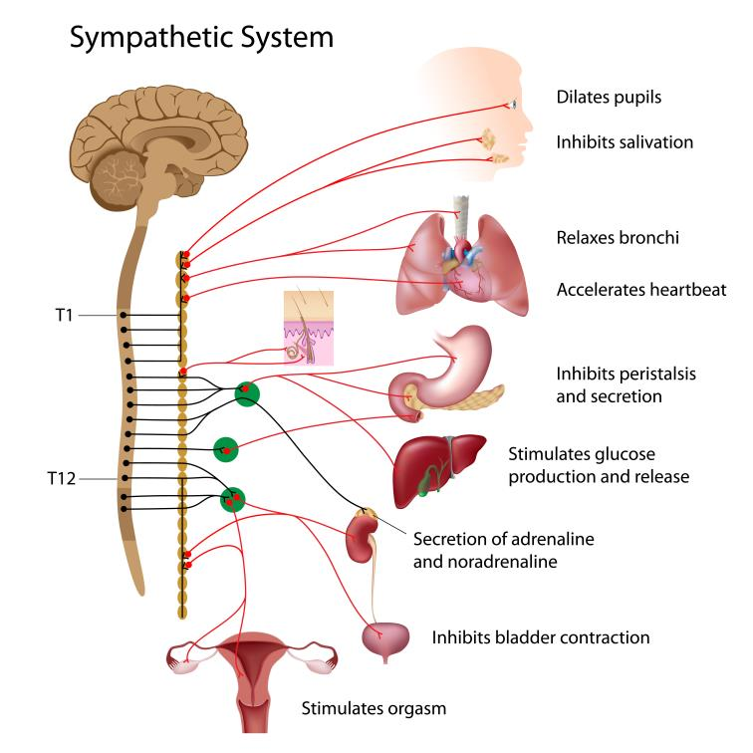
Sympathetic Nervous System
Nerves are stimulated when the body is confronted with stressful situations such as danger, intense emotion, or severe illness
Fight, flight, or freeze response
Controls a person’s heart rate, breathing rate, and ability to divert blood to skeletal muscles

Slide 5
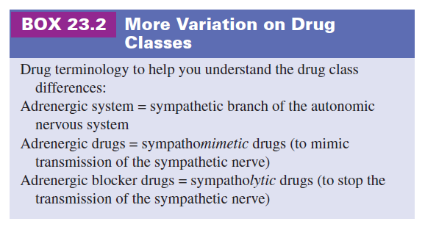
Adrenergic Drugs—Actions #1
Produce pharmacologic effects similar to the effects that occur in the body when the sympathetic nerves (norepinephrine) and the adrenal gland (epinephrine) are stimulated.

Slide 6

Pharmacology in Practice Exercise #1
Drugs that produce activity similar to the neurotransmitter norepinephrine are known as which of the following?
Sympatholytics
Antiadrenergic drugs
Sympathomimetics
Anticholinergic drugs

Slide 7
Adrenergic Drugs—Actions #2
Purpose is to divert blood flow to the vital organs so the body can deal with a stressful situation
CNS: wakefulness, quick reaction to stimuli, quickened reflexes
Autonomic nervous system: relaxation of smooth muscles of bronchi, constriction of blood vessels, sphincters of stomach, dilation of coronary blood vessels, decrease gastric motility
Metabolism: increased use of glucose, liberation of fatty acids—adipose tissue
Heart: increase in heart rate

Slide 8
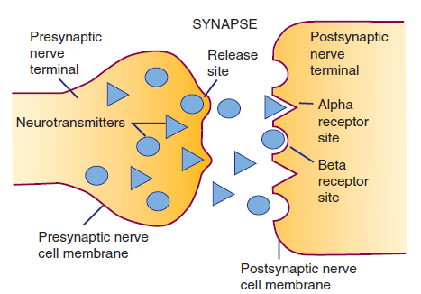
Adrenergic Drugs—Actions #3
Receptor Selectivity: the degree to which any organ is affected by the sympathetic nervous system depends on which postsynaptic nerve receptor sites are activated
Adrenergic nerves: alpha (α) or beta (β) receptors

Slide 9
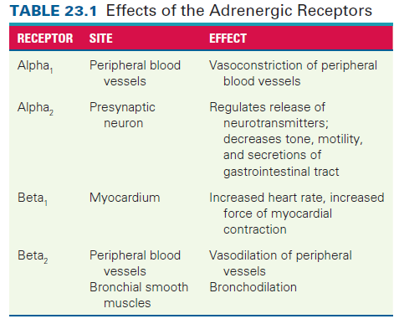
Adrenergic Drugs—Actions #4

Slide 10
Pharmacology in Practice Exercise #2
Which of the following adrenergic receptors is responsible for increased heart rate and increased force of myocardial contraction?
alpha₁ receptors
alpha₂ receptors
beta₂ receptors
beta₁ receptors

Slide 11
Adrenergic Drugs—Uses
Hypovolemic and septic shock
Moderate to severe episodes of hypotension
Control of superficial bleeding during surgery and dental procedures of the mouth, nose, throat, and skin
Cardiac decompensation and arrest
Allergic reactions (anaphylactic shock, angioneurotic edema)
Ventricular arrhythmias
Respiratory distress
Nasal congestion and glaucoma
Adjunct to anesthetics

Slide 12
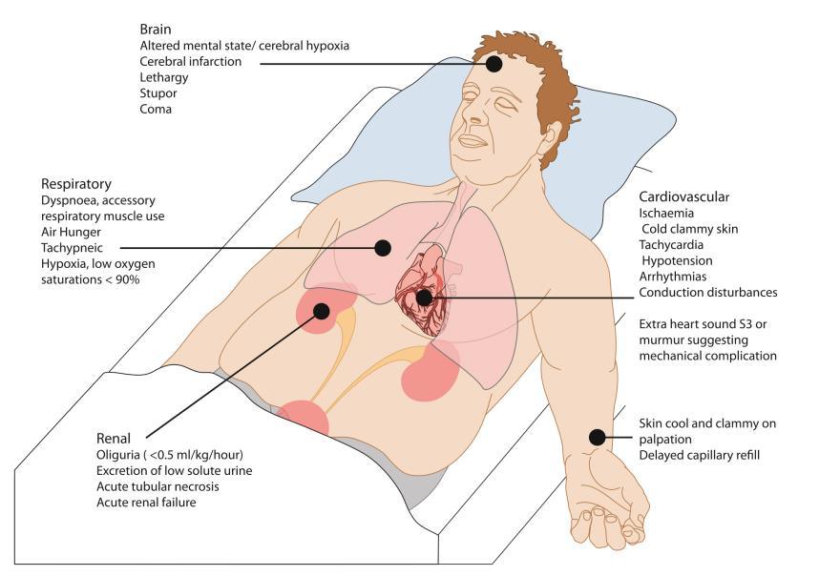
Shock
Shock is a state of inadequate tissue perfusion
Three types
Hypovolemic
Cardiogenic
Distributive
Brain activates the hypothalamic-pituitary-adrenal system—release of norepinephrine and epinephrine

Slide 13

Adrenergic Drugs—Adverse Reactions
Common Adverse Reactions:
Cardiac arrhythmias
Headache
Nausea and vomiting
Increased blood pressure
Others specific to individual drugs

Slide 14

Adrenergic Drugs—Contraindications
Contraindicated in clients with:
known hypersensitivity to adrenergics
tachyarrhythmias (isoproterenol)
pheochromocytoma, unmanaged arrythmias, or ventricular fibrillation (dopamine)
narrow-angle glaucoma (epinephrine)
hypotension (norepinephrine)
prescribed midodrine (supine hypertension)
Norepinephrine should not be used as an adjunct for local anesthesia in fingers or toes

Slide 15
Selective Serotonin Reuptake Inhibitors—Precautions
Use cautiously in clients with:
Coronary insufficiency
Cardiac arrhythmias
Angina pectoris
Diabetes
Hyperthyroidism
Occlusive vascular disease
Prostatic hypertrophy
Diabetes (lower insulin requirement)
Pregnancy category C

Slide 16
Adrenergic Drugs—Interactions
Interacting Drug | Common Use | Effect of Interaction
Antidepressants | Treatment of depression | Increased sympathomimetic effect
Oxytocin | Induction of uterine contractions | Increased risk of hypertension
Phenytoin (when given with dopamine) | Treatment of seizures | Increased risk of seizures, hypotension, and bradycardia
Beta-adrenergic blocking drugs (when given with dobutamine) | Reduce high blood pressure | Increased risk of hypertension

Slide 17

Nursing Process—Client Receiving an Adrenergic Drug #1
Preadministration Assessment
Will depend on the drug, the client, and the reason for administration.
Objective Data
Description of signs of shock or allergen, such as cool skin, cyanosis, diaphoresis, and change in level of consciousness
Vital signs (continuous monitoring)
Description of trauma, infection, or blood loss
IV access

Slide 18

Nursing Process—Client Receiving an Adrenergic Drug #2
Preadministration Assessment (continued)
Subjective Data
Type and duration of symptoms
Allergy history
Remedies attempted before seeking care

Slide 19

Nursing Process—Client Receiving an Adrenergic Drug #3
Ongoing Assessment
Observe for effect of drug, such as improved breathing of client with asthma, or response of blood pressure with administration of vasopressor
Evaluate, document drug effect, take and document vital signs (compare to baseline)
Notify primary health care provider of adverse reactions

Slide 20
Nursing Process—Client Receiving an Adrenergic Drug #4
Nursing Diagnoses
Altered Tissue Perfusion related to hypovolemia, blood loss, impaired distribution of fluid, impaired circulations, impaired transport of oxygen across alveolar and capillary bed
Decreased Cardiac Output related to altered heart rate or rhythm
Sleep Deprivation/Insomnia related to adverse reactions (nervousness) to the drug and environment

Slide 21
Nursing Process—Client Receiving an Adrenergic Drug #5
Planning
Expected client outcomes depend on the reason for administration of the adrenergic drug but may include:
Optimal response to therapy
Management of adverse drug reactions
Confidence in an understanding of the prescribed medication regimen

Slide 22
Nursing Process—Client Receiving an Adrenergic Drug #6
Implementation
Promoting Optimal Response to Therapy
Management of shock is aimed at providing basic life support; management of the client will depend on the drug, reason for administration, and client response to drug
Minimize distractions when preparing drug, exercise great care in calculation, preparation of drugs as adrenergic drugs are potentially dangerous
Report, document any complaint client may have while taking adrenergic drugs; report adverse effects such as development of cardiac arrhythmias immediately

Slide 23
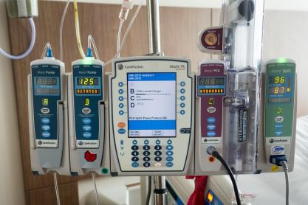
Nursing Process—Client Receiving an Adrenergic Drug #7
Implementation
Monitoring and Managing Client Needs
Altered Tissue Perfusion
Decreased oxygen, inability of body to nourish cells
Adrenergics can correct poor tissue perfusion or can contribute to the problem if drug causes hypertension in client
Type of vasopressor ordered will depend on cause of hypotension
Use an electronic infusion device

Slide 24
Nursing Process—Client Receiving an Adrenergic Drug #8
Implementation
Monitoring and Managing Client Needs
Altered Tissue Perfusion (continued)
Do not mix dopamine with other drugs (i.e., sodium bicarbonate or other alkaline IV solutions)
Do not dilute norepinephrine or epinephrine before administration
Continuously monitor the blood pressure and adjust the rate of drug administration of the IV solution to maintain client’s systolic pressure per provider’s orders
Inspect the IV site for leakage (infiltration/extravasation)

Slide 25
Nursing Process—Client Receiving an Adrenergic Drug #9
Implementation
Monitoring and Managing Client Needs
Altered Tissue Perfusion (continued)
Never leave the client unattended
Continuous monitor of heart rate, blood pressure and electrocardiogram
Intake and output
Monitor central venous pressure
Hemodynamic monitoring with pulmonary artery catheter

Slide 26

Pharmacology in Practice Exercise #4
A nurse is required to administer dopamine to a client. Which of the following nursing interventions should the nurse perform when caring for the client? Select all that apply.
Administer dopamine only via IV route
Mix dopamine with alkaline solution before administering
Use an electronic infusion device to administer these drugs
Monitor blood pressure every 30 minutes
Inspect needle site and surrounding tissues at frequent intervals

Slide 27
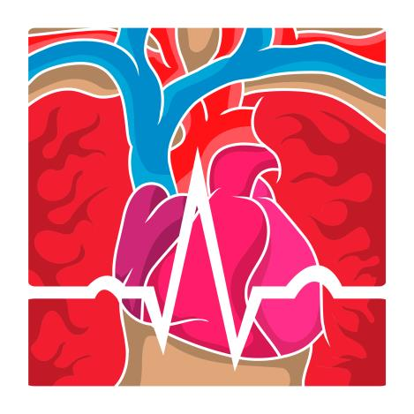
Nursing Process—Client Receiving an Adrenergic Drug #10
Implementation
Monitoring and Managing Client Needs
Decreased Cardiac Output
Heart rate, stroke volume determine cardiac output
Stroke volume: volume of blood leaving the heart

Slide 28
Nursing Process—Client Receiving an Adrenergic Drug #11
Implementation
Monitoring and Managing Client Needs
Decreased Cardiac Output (continued)
Nursing actions when a client is in shock:
Monitor vital signs to determine severity of shock
Monitor for tachycardia, thready pulse, rapid respirations or bradypnea, hypotension
Report any progressive decrease in blood pressure, a decrease in systolic blood pressure below 100 mm Hg, or any decreases of 20 mm Hg or more of client’s normal blood pressure

Slide 29

Nursing Process—Client Receiving an Adrenergic Drug #12
Implementation
Monitoring and Managing Client Needs
Sleep Deprivation/Insomnia
Critical care setting: daily pattern of activities is usually disrupted
Clients can easily get confused regarding daytime
Causes great deal of stress in client

Slide 30
Nursing Process—Client Receiving an Adrenergic Drug #13
Implementation
Monitoring and Managing Client Needs
Sleep Deprivation/Insomnia (continued)
Nursing actions when a client has sleep deprivation:
Identify factors contributing to sleep disturbance
Plan care with as few interruptions to sleep as possible (i.e., cluster care, dim lighting, vital signs/assessments only when necessary
Avoid giving client caffeinated beverages
Sleep aids

Slide 31

Nursing Process—Client Receiving an Adrenergic Drug #14
Implementation—Educating the Client and Family
Adrenergic drugs are typically given only by specially trained health care providers
Develop a teaching plan for the client and family to include:
How the drug will be given and expected results
How the client will be monitored

Slide 32

Nursing Process—Client Receiving an Adrenergic Drug #15
Implementation—Educating the Client and Family
Epinephrine auto-injectors
Teach client how to recognize signs and symptoms of allergic reaction

Slide 33

Nursing Process—Client Receiving an Adrenergic Drug #16
Implementation—Educating the Client and Family
Epinephrine auto-injectors (continued)
Teach client how to use the device (i.e., pull off the activation cap, hold the auto-injector in fist with colored cap down and swing and jab the injector into the outer thigh; hold for 10 seconds; remove and massage thigh for 10 seconds; take the empty auto-injector to the emergency department)
After injection, client may experience faster heartbeat, nausea, vomiting, sweating, dizziness, weakness, headache, and nervousness

Slide 34
Nursing Process—Client Receiving an Adrenergic Drug #17
Evaluation
Was the therapeutic effect achieved? Was the client’s perfusion maintained?
Were adverse reactions: identified, reported, and managed?
Allergic response minimized
Adequate tissue perfusion maintained
Adequate cardiac output is maintained
Client reports fewer episodes of inappropriate sleep patterns
Did client (if able) and family express confidence and demonstrate understanding of drug regimen?

Slide 35

Turn and Talk—Case Study #1
A client involved in a motor vehicle accident has just arrived in the emergency department. The client is in shock, and a preliminary examination shows significant head trauma, a spinal cord injury, and several lacerations and contusions. The blood pressure is 85/60 mm Hg.
Based on their current condition, which type of shock is the client likely exhibiting?

Slide 36
Turn and Talk—Case Study #2
A client involved in a motor vehicle accident has just arrived in the emergency department. The client is in shock, and a preliminary examination shows significant head trauma, a spinal cord injury, and several lacerations and contusions. The blood pressure is 85/60 mm Hg.
Besides hypotension, what other symptoms of shock might the emergency department nurse observe in the client?
Before the administration of the dopamine ordered by the physician, what steps should be included in the nurse’s preadministration?

